Slide 1
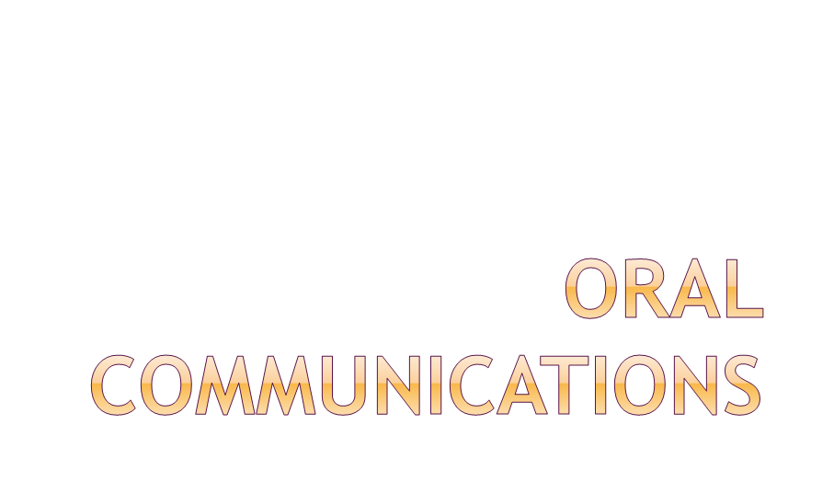

Slide 2


Meetings
Conference calls
Telephone calls
Presentations
Video or audio recordings
Giving Directions
Other forms of oral communication

Slide 3

Used slideshow created in Foundation Skills section of CTAERN Resource cd for Oral Communications.
PowerPoint slideshow and Oral Communication Test are available.
The following 15 slides are the Foundation Skills Oral Communications slide show.

Slide 4

Georgia CTAE Resource Network
Instructional Resource Office
To accompany curriculum for the Georgia Peach State Career Pathways
April 2009, Kayla Calhoun & Dr. Frank Flanders

Slide 5

Recall the key concepts of oral communication
Define the three elements of oral communication
List the steps for planning a successful oral presentation
Design a presentation outline using the 9 steps of oral communication
Describe the strengths and weaknesses of a presentation

Slide 6

Expressing ideas and information as well as influencing others through the spoken word
  Can also include nonverbal communication
Important for any career, whether you use it in informal conversations or business presentations
Key Concepts: speaker, message, channel, receiver, feedback, noise, context

Slide 7

Content: information conveyed in presentation
Organization: structure of presentation
Delivery: means of communication

Slide 8

Determine a general purpose
Analyze the audience
Choose a specific purpose
Research the topic
Organize and outline the presentation
Visual aids
Practice
Delivery
Assessment

Slide 9

Purposes:
  Inform
  Persuade
  Entertain/move

Slide 10

Relate your message to your audience’s knowledge, beliefs, and interests
Study demographic data
Consider size, setting, and prior disposition toward the topic and yourself
Important to present the most relevant information while avoiding offense

Slide 11

Narrow your topic
Ex:
  General purpose: inform
  Specific purpose: Provide information about the current issues affecting Georgia agriculture
Should be explicitly stated in introduction

Slide 12

Gathering facts, figures, testimony, and examples
Establishes credibility
  Competence: speaker’s knowledge of subject
  Character: speaker’s trustworthiness

Slide 13

Introduction
  Attention-getter
  Thesis
  Preview statement
Body: 2-5 main points
Conclusion
  Summary of main points
  Strong concluding statement

Slide 14

Organizational patterns
  Chronological
  Spatial
  Topical
  Cause-effect
  Problem-solution
Connectives
  Transitions, internal previews and summaries, signposts

Slide 15

Should add to the presentation
Visible to audience
Talk to audience, not visual aid
Explain visual aids to audience
Can be PowerPoint, graph, chart, DVD, transparency, people, etc.

Slide 16

Delivery methods:
  Manuscript
  Memorization
  Extemporaneous
  Impromptu
Be sure to practice using visual aids
Time your presentation

Slide 17

Voice: volume, pitch, pauses, articulation, pronunciation
60% of meaning from nonverbal cues
  Gestures, eye contact, posture, facial expressions
  Physical appearance
  Environment
  Being late and rushing through presentation

Slide 18

Ask for feedback from the audience
Identify strengths and weaknesses of your presentation
Slides 4-18 were used from CTAE Resource Foundation Skills lesson plans

Slide 19

Developing Listening Skills Activity
  Developing Listening Skills Handout
  Developing Skills for Understanding Handout
Following Directions Handouts
  Students complete three activities about following directions.
Telephone Etiquette Project

Slide 20

Prepare an oral presentation based on the handouts given – Informative Oral Presentation, Grading Rubric, and Self Reflection.
Each student will present their topic to the class
Classmates will evaluate each presenter and observe and record nonverbal communication gestures used during the presentation.

Slide 21

Literal Writing Activity

Slide 22

Use literal (precise) writing for accurate information in giving directions
  Make a Peanut Butter and Jelly Sandwich
or
  Wrap a Gift

